Slide 1

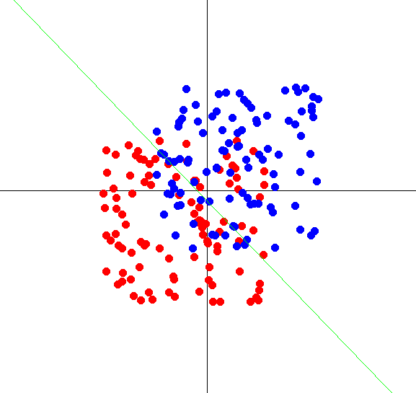
Perceptron Algorithm
Parallel Computing SS18
Lennard Flegel, Alexander Mardorf, Bajram Ibishi, Franziska Thiemann

Slide 2
Outline
The Perceptron learning Algorithm
What it does
How it does that
Why it works
Software architecture
Our implementation
Going Parallel
Benchmarking
Conclusion
Sources

Slide 3
The Perceptron Learning Algorithm (PLA)

Slide 4


Supervised Learning
Learning Algorithm
Model
Dog
Size: ***
Weight: ****
Cat
Size: **
Weight: ****
Cat
Size: **
Weight: **
Cat
Size: **
Weight: *
Extracting a rule from a set of correct data
Dog
Size: *****
Weight: ****

Slide 5
Supervised Learning
Size:**
Weight:*********
Model

Slide 6

Supervised Learning
Size:**
Weight:*********
Model
[1]
Garfield = Cat

Slide 7
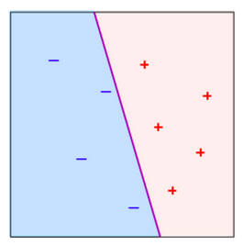
Visualizing the separator
weight
Purple line:
the separator or previously „model“
size

Slide 8
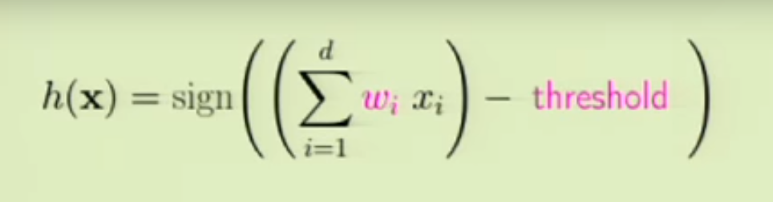
Supervised Learning
[2]

Slide 9
Supervised Learning
Weighted sum of attributes:
Like weight, size …

Slide 10
Supervised Learning
Weighted sum of attributes
Substract threshold

Slide 11
Supervised Learning
Weighted sum of attributes
Substract threshold
Check sign: + or -

Slide 12
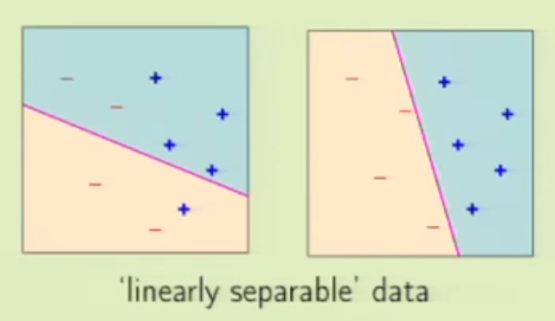


The formula behind that
Weights and threshold together form a separator

Slide 13
But wait… That doesn‘t seem right?

Slide 14
The learning part
Finding the proper separator is the „learning“ part

Slide 15
WARNING
No more cats and dogs from here on

Slide 16
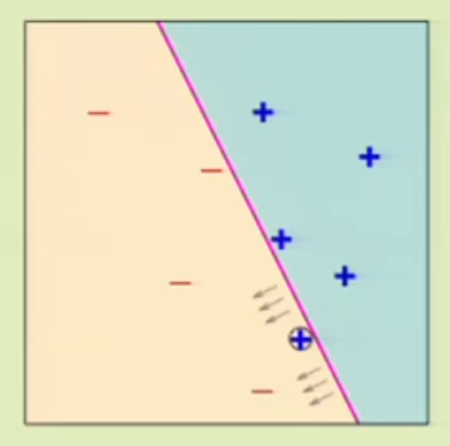
PLA Pseudocode
i = 0;
w(i) chosen randomly;
WHILE w(i) is not the solution AND i < MAXIMUM_ITERATIONS DO
choose any misclassified point p
change w(i+1) and threshold based on p
i++;
END
[2]

Slide 17
Pocket-PLA: non separable data

Slide 18
Pocket-PLA
i = 0;
bestWeightset = null; //the pocket where we keep the best result
w(i) chosen randomly;
WHILE i < MAXIMUM_ITERATIONS DO
if (w(i) better than bestWeightset)
bestWeightset = w(i);
choose any misclassified point p
change w(i+1) and threshold based on p
i++;
END
// Removed : while (w(i) is not the solution),
// there is no 100% separator
Notes:
While becomes effectively a for loop

Slide 19
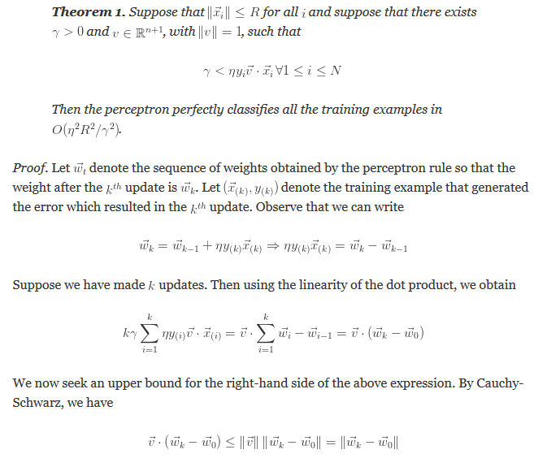
Proof
[…]
[4]
Notes:
Hier Idee zur Parallelisieren oder weiter unter ?

Slide 20

Proof
[5]
Notes:
Hier Idee zur Parallelisieren oder weiter unter ?

Slide 21
Proof
TL;DR:
It works
Notes:
Hier Idee zur Parallelisieren oder weiter unter ?

Slide 22
Software architecture
Notes:
Einzelne Klassen kurz vorstellen, Logik explizit vorstellen

Slide 23
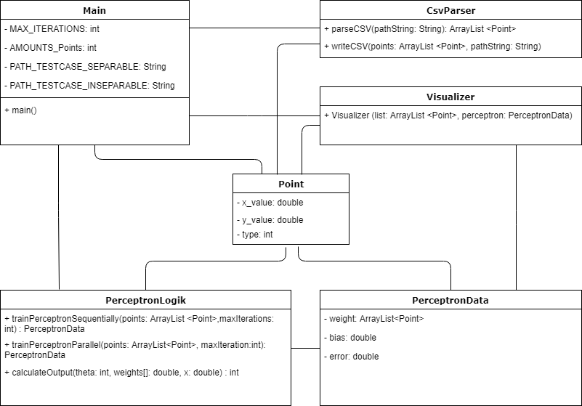
Class diagram
Notes:
To give you a quick overview of our code we have made this class diagramm, it‘s not complete but we summarize it to the most important points,
All clases using the point class, and are regulatet from the Main Class, CSV Parser for CSV Input and Output, and to visualize our results the visualizer class, our Perceptron Logik where we have our Methods for Sequetially and Parallel Training

Slide 24
Going Parallel
Notes:
Einzelne Klassen kurz vorstellen, Logik explizit vorstellen

Slide 25
Going Parallel
Java
Notes:
Java: because we like to have something special, it turns out it was very special
Quote from Homepage, but nearly the oppositue happend , it wasn‘t easy to use or user friendly, we didn‘t understand the OMP specific error messages and didn‘t find helpfull documentation, so we use threads, but the cool and helpfull things that OMP usually does for us we have to do on our own, and now we show you how we did that

Slide 26
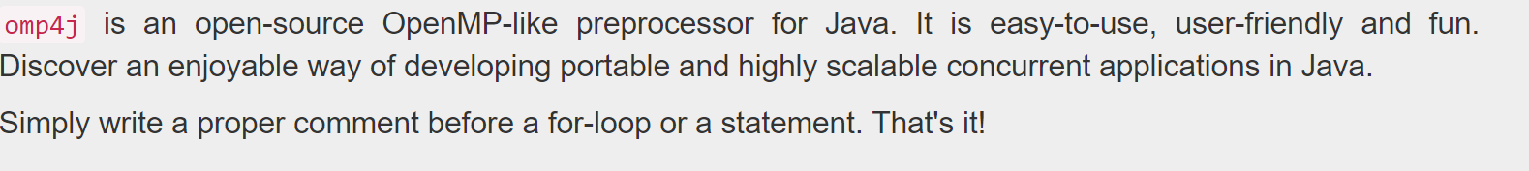
Going Parallel
Java
OMP4j
http://www.omp4j.org/
Notes:
Java: because we like to have something special, it turns out it was very special
Quote from Homepage, but nearly the oppositue happend , it wasn‘t easy to use or user friendly, we didn‘t understand the OMP specific error messages and didn‘t find helpfull documentation, so we use threads, but the cool and helpfull things that OMP usually does for us we have to do on our own, and now we show you how we did that

Slide 27
Going Parallel
Java
OMP4j
Threads
[6]
Notes:
Java: because we like to have something special, it turns out it was very special
Quote from Homepage, but nearly the oppositue happend , it wasn‘t easy to use or user friendly, we didn‘t understand the OMP specific error messages and didn‘t find helpfull documentation, so we use threads, but the cool and helpfull things that OMP usually does for us we have to do on our own, and now we show you how we did that

Slide 28
Benchmarking
Notes:
Einzelne Klassen kurz vorstellen, Logik explizit vorstellen

Slide 29
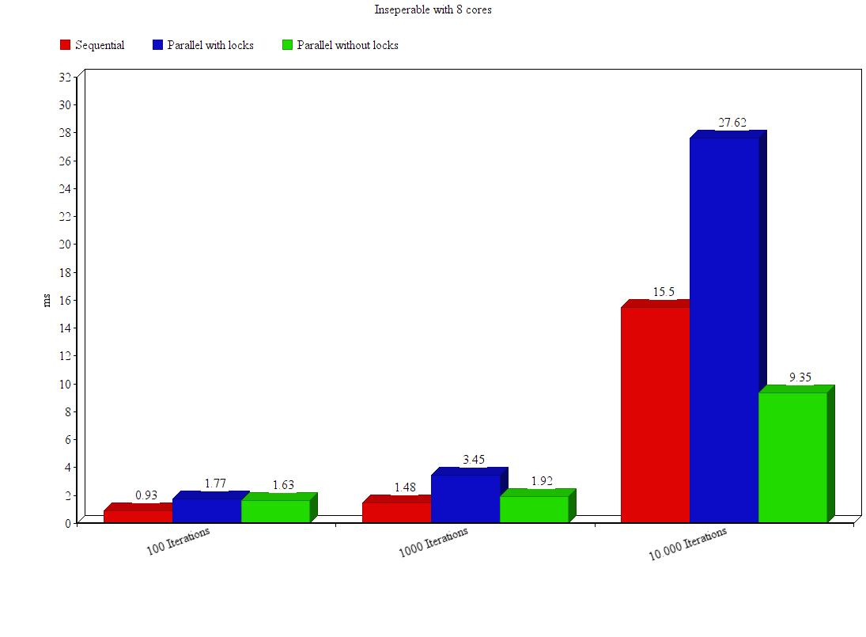
Benchmarks
Average of 100 calls
Tested with 100 Points
Notes:
Idee der Parallelisierung vorstellen

Slide 30
Benchmarks
Overhead caused by Java Threads
Notes:
Idee der Parallelisierung vorstellen

Slide 31
Benchmarks
Algorithm is by its nature not efficiently parallelizable:
All threads share „weights“ variable causing race conditions
Synchronized blocks + thread overhead hinder better performance
Notes:
Idee der Parallelisierung vorstellen

Slide 32
Conclusion
Notes:
Idee der Parallelisierung vorstellen

Slide 33
Conclusion
Reflection on what this research aimed for:
Efficient parallel implementation of the perceptron learning algorithm
Reflection on research and methods:
We had troble with the software that was to be used (OMP4J)
So we could not work the way we planned to
Result is not satisfactory as a consequence
Reflection on the final result:
goal was not achieved, algorithm with JAVA threads caused race conditions
Synchronization required
no speedup can be achieved
What‘s to be discussed :
Better with C-style preprocessor OpenMP?
Notes:
Idee der Parallelisierung vorstellen

Slide 34
Sources
[1] https://d1ejxu6vysztl5.cloudfront.net/lasagna/lasagna2-sm.jpg
[2] California Institute of Technology course „Learning from data“ held by Professor Yaser Abu-Mostafa, available at https://work.caltech.edu/lectures.html
[3]Universität Freiburg course Machiene learning held by Prof. Dr. Volker Sperschneider slide 8 available at: http://ml.informatik.uni-freiburg.de/former/_media/teaching/ss13/ml/sperschneider/08perzeptron.pdf
[4] Article Perceptron Convergence Theorem by Matt Rosenzweig posted on May 30, 2014 on his blog available at https://matthewhr.wordpress.com/2014/05/30/perceptron-convergence-theorem/
[5] Internet meme, no creator or holder of copyright found. Available at https://www.pinterest.de/pin/239113061441215691/
[6] OMP4J Homepage, available at http://www.omp4j.org/
Notes:
Idee der Parallelisierung vorstellen

